Slide 1
Open Data Workshop
Data Economy-BDA Initiative, Innovation Capital
Multimedia Development Corporation

Slide 2
Open Data- Introduction & Principles
Data Economy-BDA Initiative, Innovation Capital
Multimedia Development Corporation

Slide 3
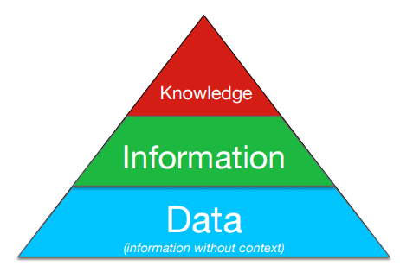
WHAT IS DATA?
A collection of facts, information and statistics that can be analyse to develop new knowledge
The lowest level of abstraction from which information and then knowledge are derived
Data can be collected through various method
“ Information is not a form of knowledge”- Albert Einstein

Slide 4
OBJECTIVE
Provide good foundation in the principles of open data and explore the good example of data usage
Know-how of open data, datasets, data publication platform and data visualisation
Best practices of open data
Law, principles and open data licensing
Encourage adoption of open data in public sector

Slide 5
OPEN DATA
What is Open Data?

Slide 6
OPEN DATA (2)
“Open data is data that can be freely used, reused and redistributed by anyone “
Source: Open Data Handbook. Org
“Open data is data that is published in an open format, is machine readable and is published under a license that allows for free reuse”
Source: Data.gov.uk
“Open data is data that is made available by organizations, businesses and individuals for anyone to access, use and share”
Source: The ODI UK
Notes:
Open format:
Data must be available and accessible.
Reuse and redistribute: data must be permitted to be re-use and redistributed including intermixing with other datasets.
Universal participations: data must be able to universally reuse, share and redistribute without any discrimination e.g. “for non-commercial purpose” that prevent commercialization of the open datasets.

Slide 7
OPEN DATA (3)
The various definition of open data:
http://thegovlab.org/open-data-whats-in-a-name/
Notes:
Open format:
Data must be available and accessible.
Reuse and redistribute: data must be permitted to be re-use and redistributed including intermixing with other datasets.
Universal participations: data must be able to universally reuse, share and redistribute without any discrimination e.g. “for non-commercial purpose” that prevent commercialization of the open datasets.

Slide 8
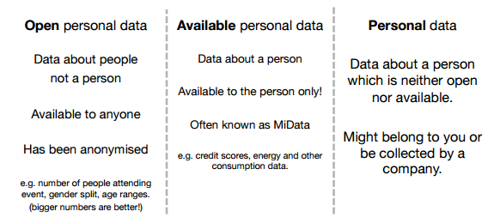
TYPE OF PERSONAL DATA
Notes:
Open format:
Data must be available and accessible.
Reuse and redistribute: data must be permitted to be re-use and redistributed including intermixing with other datasets.
Universal participations: data must be able to universally reuse, share and redistribute without any discrimination e.g. “for non-commercial purpose” that prevent commercialization of the open datasets.

Slide 9
TYPE OF PERSONAL DATA (2)
Open Data: Bring transparency and open peer review
Big Data: Bring evidences
Personal Data: Makes it relevant
Notes:
Open format:
Data must be available and accessible.
Reuse and redistribute: data must be permitted to be re-use and redistributed including intermixing with other datasets.
Universal participations: data must be able to universally reuse, share and redistribute without any discrimination e.g. “for non-commercial purpose” that prevent commercialization of the open datasets.

Slide 10
SO, WHY OPEN DATA?

Slide 11
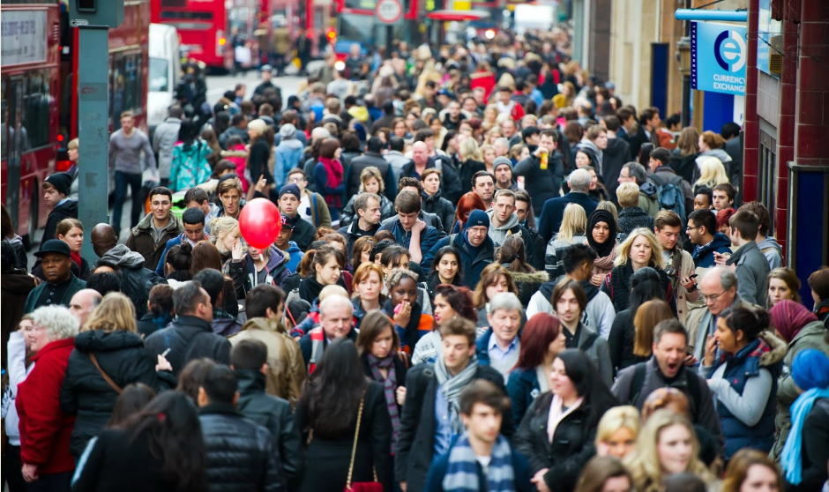
OPEN DATA IMPACT
$125 Billion
RM5.5 Billion
Worldwide market for data driven and analytics services by 2015
Converted potential productivity saving in Malaysia from traffic efficiency via Open Data e.g. creation of open innovation in public transport apps
Source: IDC & IIA
Source: MDeC Analysis
42%
£27M /Month
Companies invested in data analytics or planning to do so by 2015
Potentially savings from NHS in England last year from healthcare datasets shared in UK
Source: Gartner
Source: ODI UK

Slide 12
OPEN DATA BENEFITS
Enabling economy – open innovation, creating jobs
Reduce cost – data drive understanding of conventional system and explore value added to the current system
Transparency – driving towards transparent culture in government and businesses
Improve services – via innovative apps, productivity gain

Slide 13
OPEN DATA BENEFITS (2)
Efficient data sharing – between G2G, G2B, G2C
More high impact solutions can be created for benefits of community and rakyat

Slide 14
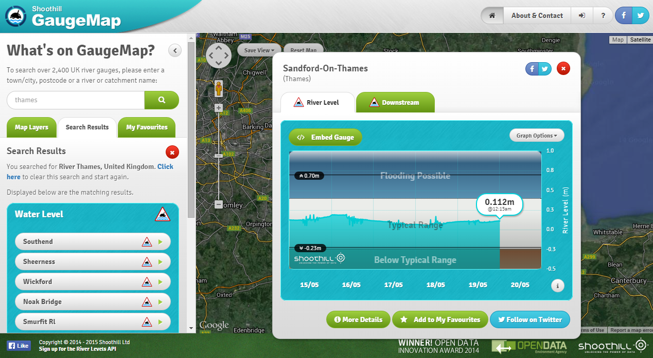
EXAMPLE OPEN DATA APPS
Gaugemap (Measure river depth)

Slide 15
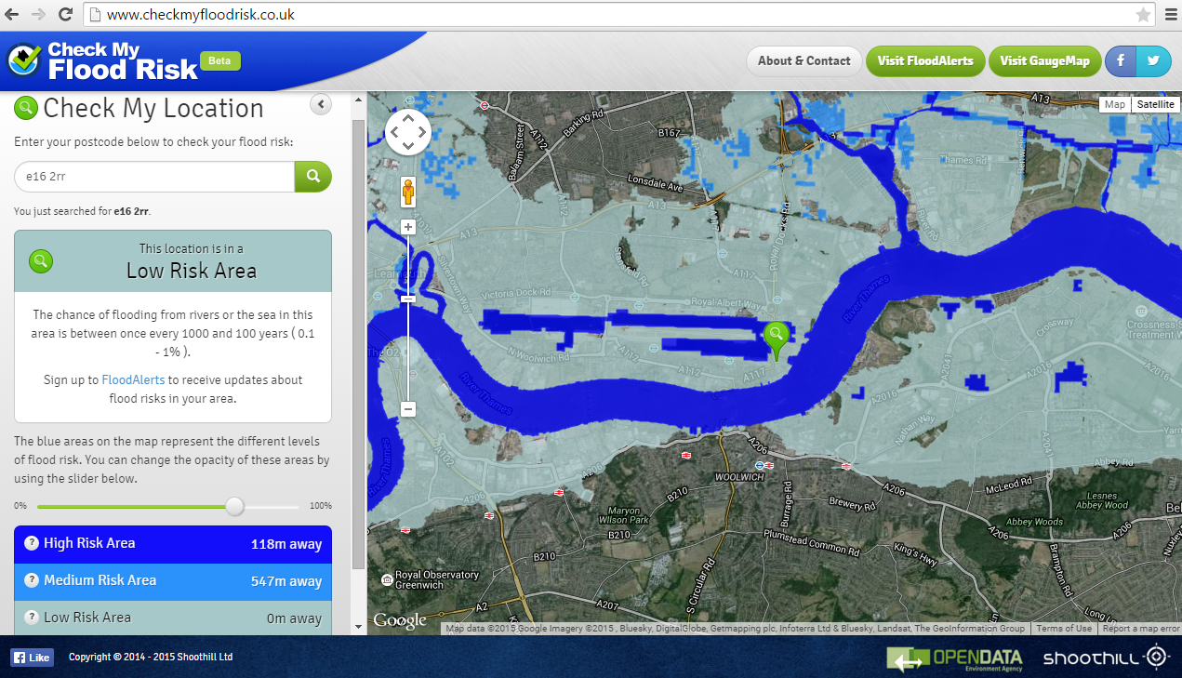
EXAMPLE OPEN DATA APPS (2)
checkMyFloodRisk (Flood alert apps)

Slide 16
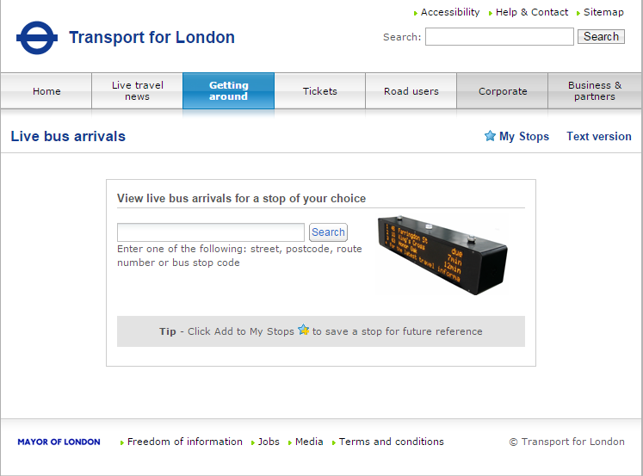
EVOLUTION OF APPS FROM OPEN DATA
For example, check TFL websites (http://countdown.tfl.gov.uk/)

Slide 17
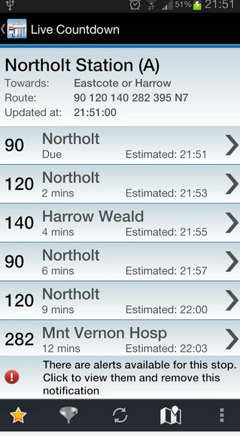
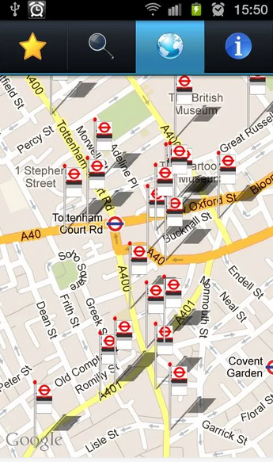
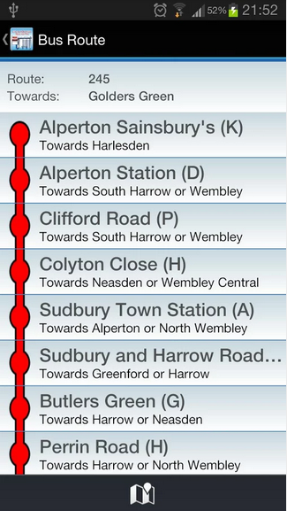
EVOLUTION OF APPS FROM OPEN DATA
Now check this apps (Live London Bus Tracker) , what is the similarity? What data that this app used?

Slide 18

DISCUSSION
Why are you opening the data? What kind of data that can be open? Give examples
What type of application from the data you open?
How can it bring benefits?

Slide 19
Open Data – Law and Licensing
Data Economy-BDA Initiative, Innovation Capital
Multimedia Development Corporation

Slide 20
OBJECTIVE
Understand what is Open Data License
Increase confidence in using Open Data License
Understand Garis Panduan Data Terbuka Sektor Awam

Slide 21
LAW AND LICENSE
Why Open Data License?
Provides clarity and set out how and what user and re-user are permitted to do with your datasets
What is Open Data License?
Open Data License identify what is Open Data and who can use it, what is permitted & what is the restriction of using the data.

Slide 22
LAW AND LICENSE (2)
Malaysia in the midst of strengthen Open Data License on Data.gov.my
Example taken from UK Open Data License
http://www.nationalarchives.gov.uk/doc/open-government-licence/version/2/

Slide 23
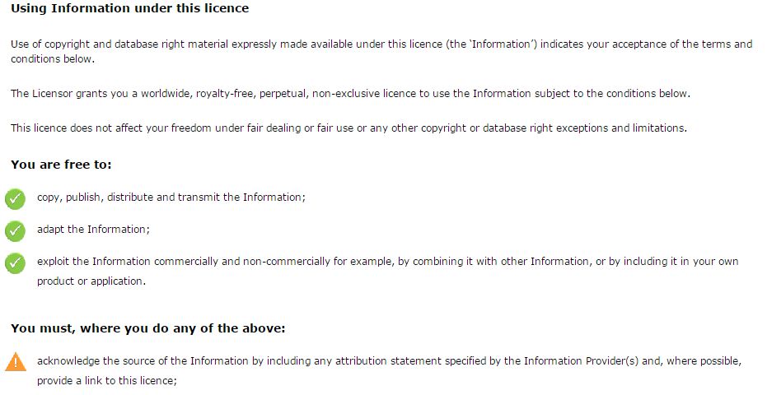
LAW AND LICENSE (3)

Slide 24
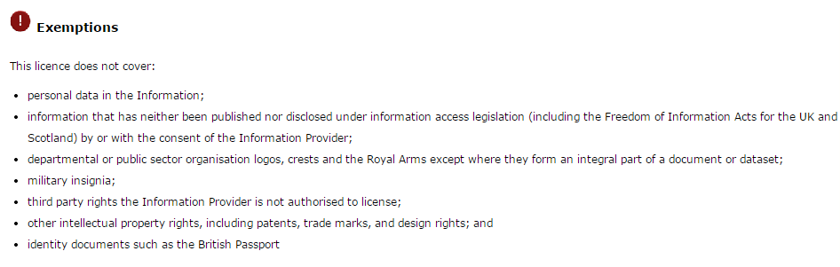
LAW AND LICENSE (4)

Slide 25
LAW AND LICENSE (5)
Be careful!
Personal Data
Information that been accessed unlawfully
Third party IP rights i.e. datasets that contain other party rights, map, images, excerpts of text

Slide 26
GARIS PANDUAN DATA TERBUKA SEKTOR AWAM
Basically a guideline of classifying, identifying and publishing open data across agencies and public sector.
Enabling public sector to understand open data principal
What?

Slide 27
GARIS PANDUAN DATA TERBUKA SEKTOR AWAM (2)
Imply the definition and principal of open data, terms of open data usage, checklist of open datasets and implementation council of open data in public sector
http://data.gov.my/folders/others/Garis_PanduanBeta_Ver_1.0_01042015.pdf

Slide 28
Open Data – Best Practices and Ensuring Data Quality
Data Economy-BDA Initiative, Innovation Capital
Multimedia Development Corporation

Slide 29
BEST PRACTICES
Open Data definition according to Data.gov.my
“Open data is data that is published in an open format, is machine readable and is published under a license that allows for free reuse.”

Slide 30
BEST PRACTICES (2)
Definition of Open Format:
Data must be available and accessible.
Reuse and redistribute: data must be permitted to be re-use and redistributed including intermixing with other datasets.
Universal participations: data must be able to universally reuse, share and redistribute without any discrimination e.g. “for non-commercial purpose” that prevent commercialization of the open datasets.

Slide 31
BEST PRACTICES (3)
Definition of Machine Readable:
Data or metadata which is in a format that is understood by machine
Examples: Comma separated values (CSV), Excel (XLS), XML, HTML etc.

Slide 32
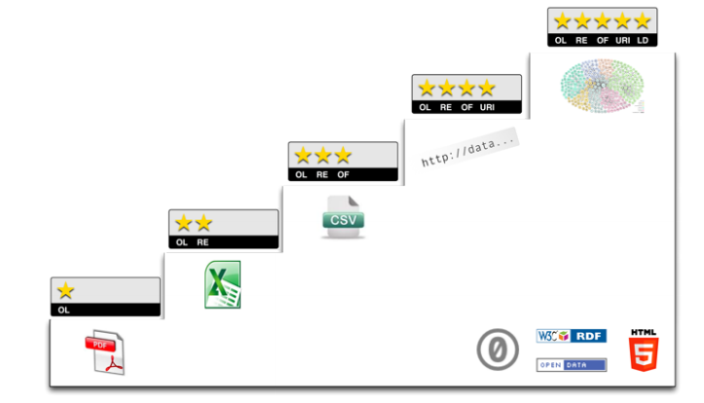
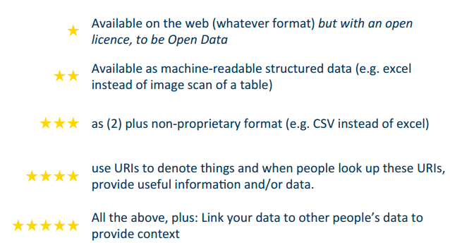
BEST PRACTICES (4)
Source:http://5stardata.info/

Slide 33
BEST PRACTICES (5)
4 aspects to look for opening up data:
Legal
Technical
Practical
Social

Slide 34
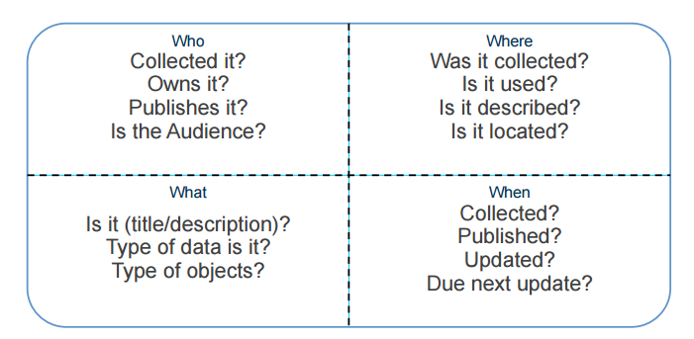
BEST PRACTICES (6)
Adding aspects context:

Slide 35
BEST PRACTICES (7)
Legal
Right to publish
Data licensed
Content licensed
Clear privacy statement
Source of data documented
Audited anonymisation

Slide 36
BEST PRACTICES (8)
Technical
Data hosted online
Type of data refined
Machine readable format
Clear technical documentation
Data can be verified

Slide 37
BEST PRACTICES (9)
Practical
Quality controlled
Listed in collection
Useable period described
Discoverable from main homepage
Referenced from publication or application

Slide 38
BEST PRACTICES (10)
Social
Support for improving/fixing
Email support
Discussion group/forum
Social media channel
Supported community
Tools and guide available to work with data

Slide 39
BEST PRACTICES (10)
Our objectives:
At least 3 star data ranking
Enhancement on data portal
Balanced supply and demand of open datasets
Continuous support from community

Slide 40
Q&A
Thank you!

Slide 41
Open Data – Data Validation, Publication & Visualization
Data Economy-BDA Initiative, Innovation Capital
Multimedia Development Corporation

Slide 42
DISCOVERING OPEN DATA
The best practical to publish data, is to think as a data consumer itself
There is no point to publish data that not reliable and can’t be use
Few questions we need to ask:
Do we understand what is the dataset?
Do we understand about the data?
Does it clean?
Am I able to access the data?
Is the data too granular? Too generic? Etc.

Slide 43
DISCOVERING OPEN DATA (2)
Please open/fork Workshop Github for exercise:
http://github.com/chlorofell/OpenDataWorkshop

Slide 44
DISCOVERING OPEN DATA (3)
Exercise 1:
To understand what is dataset and best format of datasets
Key Points:
Differentiate both datasets
Analyse best practice between both datasets
Improvement on datasets

Slide 45
DATA CLEANING AND VALIDATION
What would you do next? Once you identify the datasets that can be open?
Verify that the datasets according to Open Data Principles – anonymous, not too aggregated etc.
Perform data cleaning- granular as possible, meaningful, no duplication etc.
Format change to machine readable CSV, XLS, XML etc.

Slide 46
DATA CLEANING AND VALIDATION (2)
Once we identify the dataset, we need to ensure that dataset is free from error. A problem dataset can contain few errors such as:
Multiple representation
Duplicate records
Summation records – summation formula etc.
Redundant Data
Mix use of numerical scale
Spelling errors
Date Validation – British and America Date

Slide 47
DATA CLEANING AND VALIDATION (2)
There are few methods of how to perform data cleaning and validation:
Manual method – self-identifying
Using data cleaning tools :
- Open Refine (openrefine.org)
- Data Cleaner (datacleaner.org)
- Data Wrangler (http://vis.stanford.edu/wrangler/)

Slide 48
DATA CLEANING AND VALIDATION (3)
Exercise 2:
To perform data cleaning using Open Refine
Key Points:
Identify errors on datasets
Perform data cleaning
Understand to data cleaning tools
http://github.com/chlorofell/OpenDataWorkshop

Slide 49
DATA PUBLICATIONS
Data publication platform is which all the catalogues of datasets resides and published, for public access
Data can be publish using open source platform or using traditional websites
Examples: data.gov.my, data.gov.uk hosted on self-build platform

Slide 50
DATA PUBLICATIONS (2)
2 types of Data Publication platform:
Integrated platform
Specialist platform

Slide 51
DATA PUBLICATIONS (3)
Integrated Platform
- Build on top of organisation main website
No separation from other authoritative data
No new platform to learn
Easy to search for data
Specialist platform
Open Data focus platform
Clear workflow of publishing data
Virtualization tools
Ease to setup and maintain

Slide 52
DATA PUBLICATIONS (4)
Best practices of publishing data:
Separate from the main websites
Design to publish data, not fulfilling other organisations’ goal
Host the data, control and monitor the input and output log
Provide data services – tools and visualization in one portal
Best if data can be share as in API e.g. transport API

Slide 53



DATA PUBLICATIONS (5)
Example of Data Publication Specialist:
CKAN (http://demo.ckan.org/)
Open Data Soft (https://www.opendatasoft.com)
Socrata (www.socrata.com)

Slide 54
DATA VISUALIZATION
Data visualization transform data into more meaningful insight for analysis
It helps to improve the understanding of the data
Use data as the source to tell the stories and making impact i.e. about the trends, historical data, maps/cartograph etc.

Slide 55
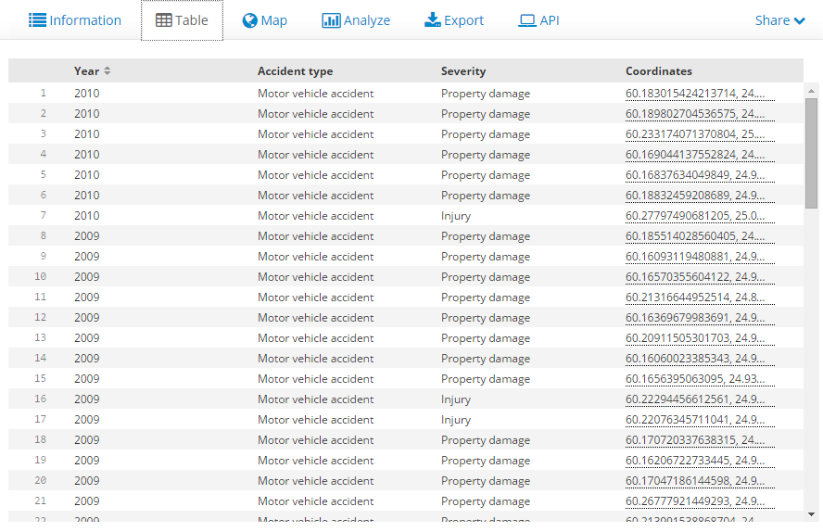
DATA VISUALIZATION (2)
For example, using OpenDataSoft platform to transform Accident datasets into user-friendly visualization for better insight

Slide 56
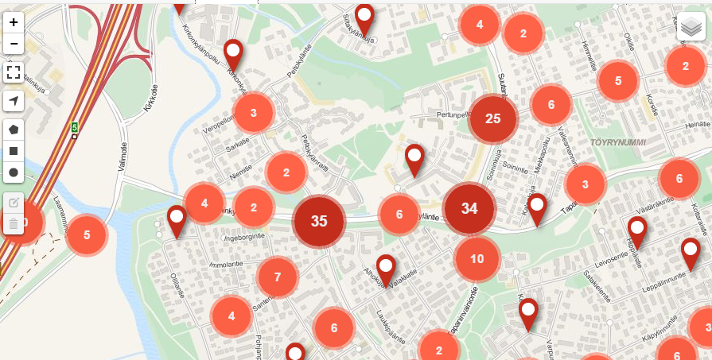
DATA VISUALIZATION (3)
Visualization transforms the datasets to cartograph for analysis

Slide 57
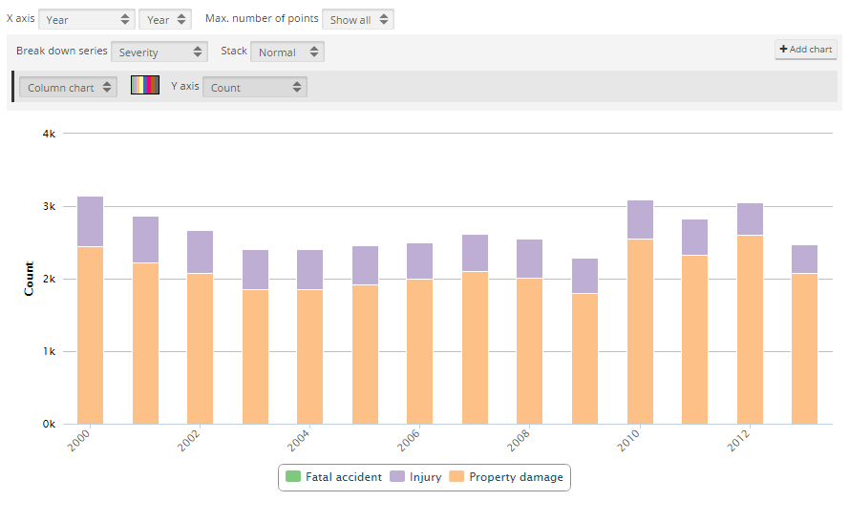
DATA VISUALIZATION (4)
Visualization transforms the datasets to Bar Chart for analysis

Slide 58
DATA VISUALIZATION (5)
Other data-driven visualization tools:
-Plot.ly (www.plot.ly)
-CartoDB (www.cartodb.com)
-D3 (http://d3js.org) – Using Java Script

Slide 59
DATA VISUALIZATION (6)
Exercise 3:
Learn translating dataset to a meaningful visualization and analysis insights
Key Points:
Identify use-cases, datasets and create story from data
Perform data cleaning and validation using ScraperWiki
Use plot.ly to visualize dataset
http://github.com/chlorofell/OpenDataWorkshop

Slide 60
DATA VISUALIZATION (7)
Exercise 3:
Publish Visualization Output at:
http://chlorofell.github.io/OpenDataWorkshop

Slide 61
Thank you
“Data is a means, not an end.”
.
BDWKL 2015- National BDA Forum

